Slide 1
Announcements
HW 2 is posted
Please read the directions VERY carefully
Review questions for exam are posted
Submit via canvas by October 11
Seats open for Friday’s speaker series for NUTR 600
Sustainable foods of past, present, and future: BUGS, Bacon, and Breast Milk

Slide 2
Carbohydrates: 1) Structure and Properties 2)Digestion and Absorption 3) Carbohydrate Metabolism

Slide 3
CHO Metabolism Overview
Glycogen metabolism
Glycogenesis
Glycogenolysis
Glucose metabolism
Glycolysis
Krebs cycle (TCA Cycle)
Electron transport chain
Gluconeogenesis
Pentose Phosphate Shunt
Cori and Alanine cycles

Slide 4
Metabolism of Macronutrients
Unit 2: Carbohydrates
glycogenesis
Glycogen
Glucose
glycogenolysis
Unit 4: Lipids
glycolysis
gluconeogenesis
Lipolysis
β-oxidation
Lipogenesis
Nitrogen
pyruvate/lactate
Acetyl Co A
Kreb’s Cycle
Electron Transport Chain
Unit 3: Proteins
(Amino acids)
H₂O, CO₂, ATP

Slide 5
Glycolysis Learning Objectives
Understand the breakdown of glucose, fructose and galactose via the glycolysis and the different fates of the end product (pyruvate)
Describe each step of glycolysis
Focus on regulatory enzymes
utilization or production of ATP
ETC and Krebs Cycle (TCA cycle) Objectives
Understand what a reducing equivalent is
Overview of the role of the electron transport chain in energy production
Understand the Krebs Cycle as an important metabolic fate of pyruvate for the production of energy

Slide 6
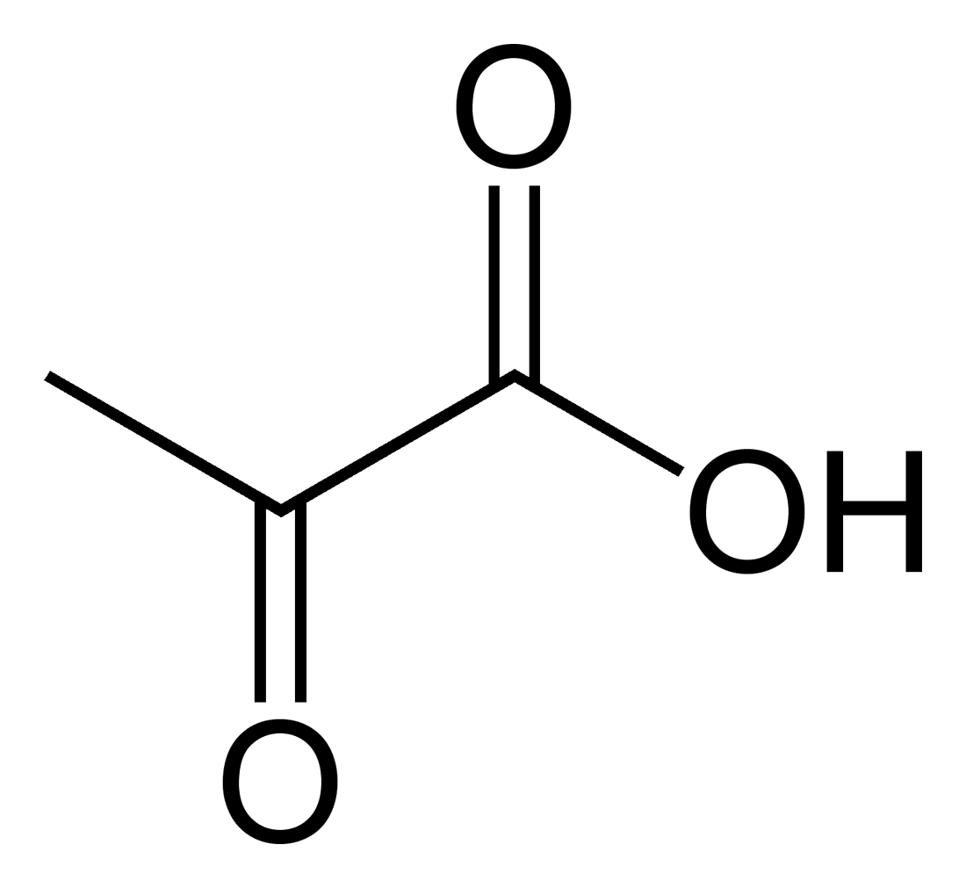
Glycolysis
Main pathway of monosaccharide degradation
Main tissue sites: Liver, muscle
Occurs in cytoplasm of the cell
Glucose conversion to two 3-carbon products: pyruvate
Two Pyruvates (triose)
Glucose
(hexose)
Overall Reaction of Glycolysis

Slide 7
Glycolysis
End product: two pyruvates
Supply energy to cells in aerobic conditions (Krebs cycle)
Produce lactate in anaerobic conditions
Converted back to glucose (gluconeogenesis) or fatty acids
Two
Pyruvate (triose)
Glucose
(hexose)

Slide 8
Glycolysis
Glucose
G-6-P
F-6-P
F-1,6-BP
HK (hexokinase)
PFK (Phospho-
Fructokinase)
GK (glucokinase)
2 GA3P
2 PEP
2 Pyruvate
DHAP
PK
(pyruvate kinase)

Slide 9
Glycolysis (glucose)
Reaction 1 (energy consuming: 1 ATP):
Glucose
Reaction 2:
Hexokinase (muscle)
Glucokinase
(liver)
Glucose 6-Phosphate
ATP
ADP
Glucose phosphate isomerase
Glucose 6-Phosphate
Fructose 6-Phosphate

Slide 10
Glycolysis (glucose)
Reaction 3 (energy consuming: 1 ATP):
Regulatory step
Rate limiting step of glycolysis
ATP is a negative modulator
product not used in other metabolic paths
Phosphofructokinase
Fructose 6-Phosphate
Fructose 1,6 bis-Phosphate
ATP
ADP

Slide 11
Glycolysis (glucose)
Reaction 4:
Aldolase
Glyceraldehyde 3-Phosphate
Fructose 1,6 bis-Phosphate
Dihydroxyacetone phosphate (DHAP)

Slide 12
Glycolysis (glucose)
Reaction 5:
Reaction 6 (energy producing in aerobic conditions: NADH):
Triosephosphate isomerase
Glyceraldehyde
3-Phosphate
DHAP
Glyceraldehyde 3-Phosphate dehydrogenase
Two Glyceraldehyde
3-Phosphate
Two
1,3 bis-P-glycerate
P_{i}
NAD
NADH
ETC to produce ATP in aerobic conditions

Slide 13
Glycolysis (glucose)
Reaction 7 (energy producing: ATP):
Phosphoglycerate kinase
Two 1,3 bis-P-glycerate
Two
3-P-glycerate
ADP
ATP

Slide 14
Glycolysis (glucose)
Reaction 8:
Reaction 9:
Series of Kinase reactions
3 -P-glycerate
2-P-Glycerate
Enolase
2-P-Glycerate
Phosphoenolpyruvate (PEP)

Slide 15
Glycolysis (glucose)
Reaction 10 (energy producing: ATP):
Regulated enzyme
ATP will negatively modulate
Pyruvate kinase
Two PEP
Two Pyruvate
ADP
ATP

Slide 16
Glycolysis Net ATP
Note: NADH is energy equivalent to 3 ATP
Energy Consuming Reactions:
Reactions 1: 1 ATP
Reaction 3: 1 ATP
Energy Generating Reactions:
Reaction 6: 1 NADH x 2 (3 ATP x 2 = 6 ATP)
Reaction 7: 1 ATP x 2 (2 ATP)
Reaction 10: 1 ATP x 2 (2 ATP)
Net Energy Gain:
4 ATP + 2 NADH minus 2 ATP = 8 ATP generated from glycolytic breakdown of glucose

Slide 17
Glycolysis: Glc → 2 pyr+4 ATP+2 NADH
GK (Glucokinase)
Glucose
G-6-P
F-6-P
F-1,6-BP
HK (hexokinase)
PFK (Phospho-
Fructokinase)
-1 ATP
-1 ATP
1 NADH x 2
2 GA3P
2 PEP
2 Pyruvate
DHAP
1 ATP x 2
PK
(pyruvate kinase)
1 ATP x 2

Slide 18
Glycolysis summary
The first reaction’s enzyme in glucose breakdown depends on the tissue (hexokinase vs glucokinase)
Similar reaction and regulation as in glycogen metabolism
Phosphofructokinase and pyruvate kinase are an important regulatory enzymes
Final products are 2 pyruvates (two 3-carbon molecules)
Total of 8 ATP equivalents result after taking into account ATPs and reducing equivalents (NADH) consumed and generated

Slide 19
Glycolysis (fructose)
ADP
Fructose 6-Phosphate
(Extrahepatic tissues)
Fructose 1,6
bis-Phosphate to Pyruvate
ATP
Fructose
Fructose Kinase
Glyceraldehyde
Fructose
1-Phosphate
(Liver)
ATP
ADP
DHAP
Glyceraldehyde
3-Phosphate to Pyruvate

Slide 20
Glycolysis (fructose)
Fructose
Fructose Kinase
Glyceraldehyde
Fructose
1-Phosphate
(Liver)
ATP
ADP
DHAP
bypasses the major regulatory step of phosphofructokinase that plays a role in glycolysis regulation
Two
Pyruvate
Two Glyceraldehyde
3-Phosphate

Slide 21
Glycolysis (fructose) Summary
Fructose in extrahepatic tissues is unfavorable
Fructose glycolysis in liver begins with FK
Bypasses important regulatory step in glycolysis
Reaction 3 (phosphofructokinase)
Pyruvate products may be shifted to pathways involved in fatty acid or cholesterol synthesis

Slide 22
Glycolysis (galactose)
Galactokinase
(Liver)
Galactose
Galactose 1-Phosphate
UDP-glucose + galactose 1-phosphate uridylydtransferase
ATP
ADP
Phospho-glucomutase
Glucose 6-Phosphate
Glucose 1-Phosphate
Glycogen
Metabolism
Pyruvate (glycolysis)

Slide 23
Glycolysis (Galactose) Summary
Galactose kinase phosphorylates galactose to galactose 1-phosphate
Galactose 1-P is coverted to Glucose 1-phosphate
G1P has different fates dependent on energy needs:
Glycogenesis
Glycolysis

Slide 24
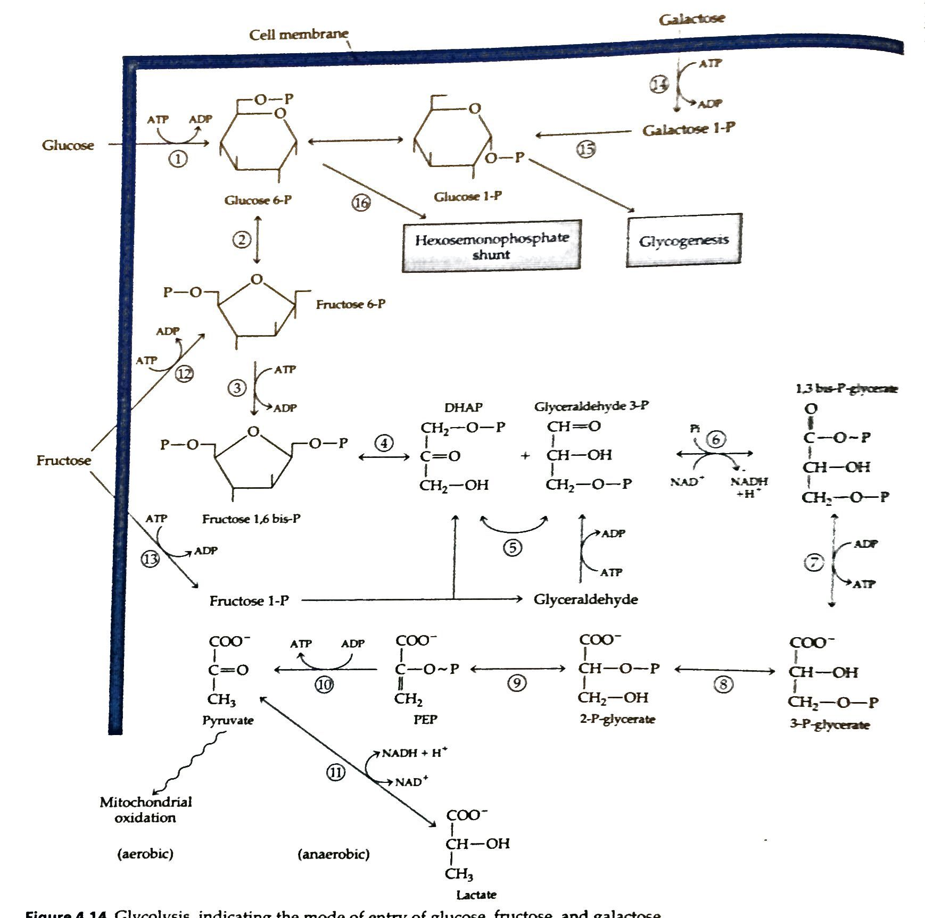
Glycolysis
Notes:
Numbers in this figure do not match up to my reactions numbers in the slides.

Slide 25
Fate of glycolysis end product pyruvate: anaerobic conditions
Pyruvate fate in anaerobic conditions
Muscle tissue
Prolonged muscular activity
NAD recycled back for use in glycolysis or other metabolic paths
Lactate dehydrogenase
Liver for glucose conversion
Pyruvate
Lactate
*NADH + H is from reaction 6 of glycolysis:
Glyceraldehyde 3-phosphate → glycerate
*NADH
NAD

Slide 26
Fate of glycolysis end product pyruvate: aerobic conditions
Pyruvate fate in aerobic conditions
Krebs Cycle (or TCA cycle or citric acid cycle)
Enters mitochondria
Complete oxidation of pyruvate occurs
Reducing equivalents enter into electron transport chain
Substrate-level ATP production

Slide 27
CHO Metabolism Overview
Glycogen metabolism
Glycogenesis
Glycogenolysis
Glucose metabolism
Glycolysis
Krebs Cycle (TCA cycle) (Citric Acid Cycle) – Pyruvate conversion to acetyl CoA (first substrate entering into Kreb’s)
Electron transport chain – overview of ETC, explanation of reducing equivalents
Pentose Phosphate Shunt
Cori Cycle
Gluconeogenesis

Slide 28
Pyruvate Fate
Pyruvate fate in aerobic conditions
Krebs Cycle (or TCA cycle)
Pyruvate enters mitochondria of the cell
Series of dehydrogenation reactions to produce reducing equivalents
Reducing equivalents are completely oxidized by donating hydrogens and electrons to ETC for ATP production
ATP generation:
Oxidation of reducing equivalents from Kreb’s cycle (and lesser extent glycolysis) via electron transport chain
Substrate-level ATP formation

Slide 29
Krebs Cycle: Electron Transport Chain
ETC results in reoxidation of reducing equivalents
NAD and FAD become reducing equivalents (i.e., FADH2 and NADH) through action of dehydrogenases in Kreb’s cycle
Reducing equivalent:
dehydrogenase
MH₂
M
(Reduced state)
(Oxidized state)
NAD
(oxidized)
NADH + H (reduced)

Slide 30
Krebs Cycle: Electron Transport Chain
NADH donates hydrogen and electrons to ETC and is not in its oxidized state again (i.e., NAD)
dehydrogenase
MH₂
M
(Reduced state)
(Oxidized state)
NAD
NADH + H (reduced)
NADH is reoxidized back to NAD by donating Hs and electrons to ETC

Slide 31
Krebs Cycle: Electron Transport Chain
Example of reduction and reoxidation: reaction 6 described in glycolysis
Glyceraldehyde 3-Phosphate dehydrogenase
Two Glyceraldehyde
3-Phosphate
Two
1,3 bis-P-glycerate
P_{i}
NAD
NADH (Reduced)
NADH is reoxidized back to NAD by donating Hs and electrons to ETC

Slide 32
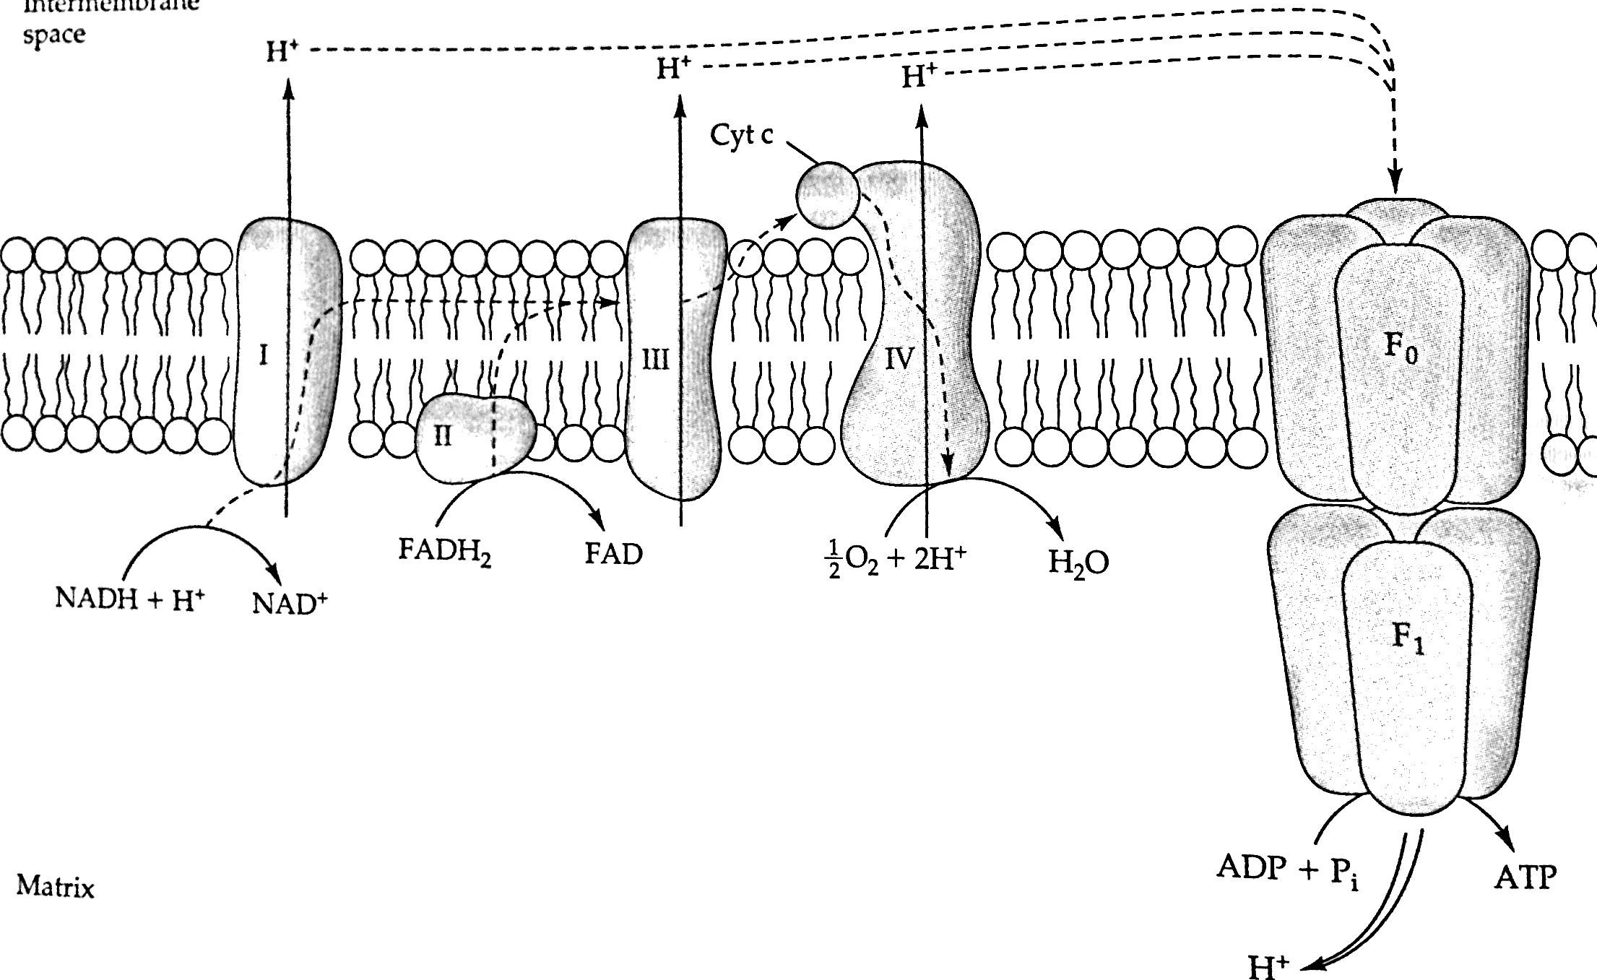
Electron Transport Chain Overview
Electrons/hydrogens transferred along the electron transport chain via proton gradient
Results in large release of energy in form of ATP
Oxygen is final hydrogen acceptor to become H2O
ATP synthase

Slide 33
Electron Transport Chain Key Points
FAD and NAD are cosubstrates that become reduced by dehydrogenases
Reducing equivalents transport electrons/hydrogens to electron transport chain
Become reoxidized – hence overall process is referred to as complete oxidation
Hydrogens/electrons travel along concentration gradient releasing energy to drive ATP synthase to produce ATP

Slide 34
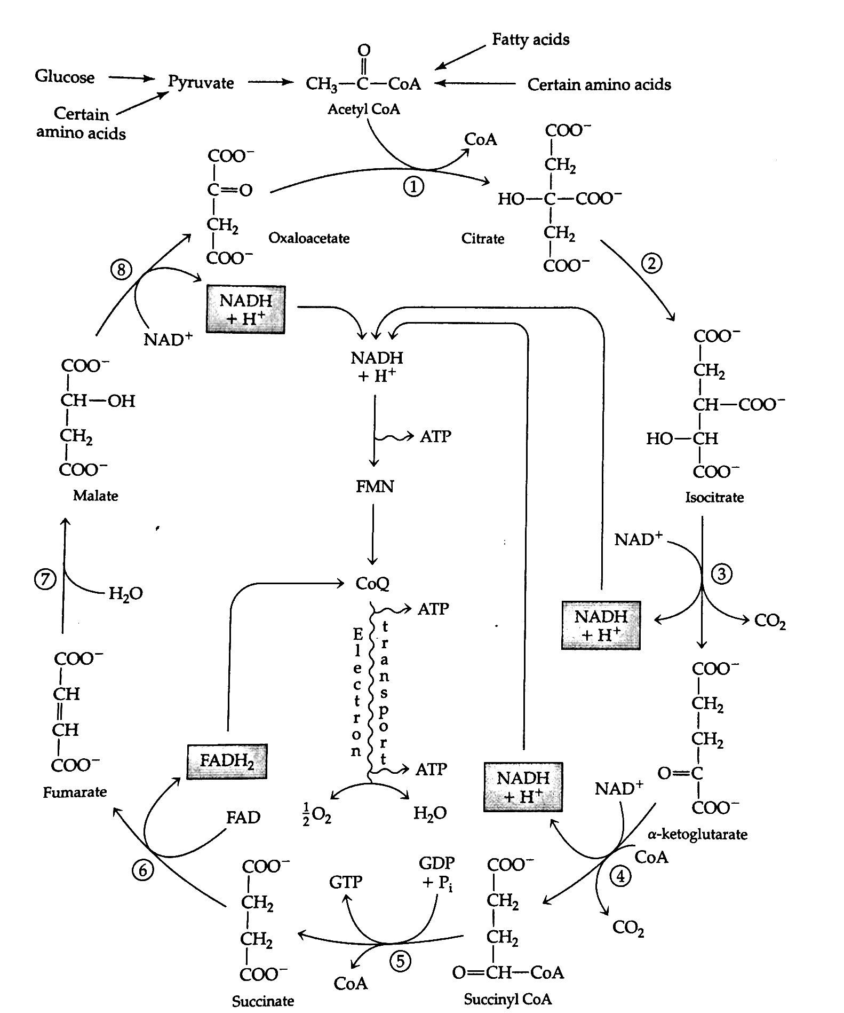
Krebs Cycle

Slide 35
Krebs Cycle
Pyruvate dehydrogenase reaction:
Enzymes of PDH Complex:
Pyruvate decarboxylase (E1)
Dihydrolipoyl dehydrogenase (E2)
Dihydrolipoyl transacetylase (E3)
Pyruvate dehydrogenase complex
Pyruvate
Acetyl CoA
NAD
NADH + H
CoA
CO2

Slide 36
Krebs Cycle
Pyruvate dehydrogenase reaction:
Regulators: NADH and Acetyl CoA (both negative)
Cofactors of PDH Complex: Coenzyme A (B₅), thiamin diphosphate (B₁), NAD (B₃), FAD (B₂), mg, and lipoic acid
Pyruvate dehydrogenase complex
Pyruvate
Acetyl CoA
NAD
NADH + H
CoA
CO2

Slide 37
Krebs Cycle
Pyruvate dehydrogenase complex
Pyruvate
Acetyl CoA
Important Points:
Pyruvate in cytosol is transferred into mitochondria
Dehydrogenase reaction in mitochondria forms acetyl CoA: regulation by NADH and product
Reaction driven my multi-enzyme complex
Requiring many b-vitamins for function and structure
NAD serves as hydrogen acceptor as NADH
NADH enters ETC

Slide 38
ETC and PDH Summary
Krebs cycle creates reducing equivalents that transfer hydrogen and electrons to the ETC
Hydrogens and electrons create gradient resulting in release of energy in form of ATP
Pyruvate enters mitochondria and is converted into acetyl CoA
PDH is a complex enzyme system
Requires variety of B vitamins to work
Regulated by NADH and its product
End product is acetyl-CoA which will enter the Krebs cycle
Will continue with Krebs and gluconeogenesis on Monday!!

Slide 39
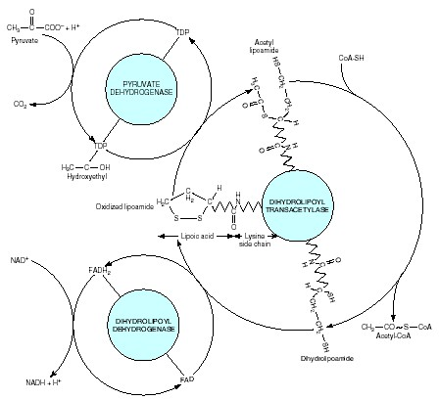
Pyruvate dehydrogenase (PDH) complex: multienzymes consisting of vitamin B cofactors
Pyruvate
TDP (thiamin diphosphate)
CoA-SH
(pantothenic acid)
CO2
(nicotinamide
adenine dinucleotide) Niacin
Acetyl Co A
NADH
FAD (flavin adenine dinucleotide)
riboflavin

